Slide 1
Employee Data Analysis using Excel
STUDENT NAME: SRIVINDHYAA G
REGISTER NO: 3122102727(ASUMN 1369312210272)
DEPARTMENT: B.COM A&F
COLLEGE: GURU SHREE SHANTIVIJAI JAIN COLLEGE FOR WOMEN

Slide 2
PROJECT TITLE
Employee Performance Analysis using Excel

Slide 3


AGENDA
Problem Statement
Project Overview
End Users
Our Solution and Proposition
Dataset Description
Modelling Approach
Results and Discussion
Conclusion
3/21/2024 Annual Review

Slide 4

PROBLEM STATEMENT
Data Analytics is the discovery, interpretation, and communication of meaningful patterns in data. Especially valuable in areas rich with recorded information, analytics relies on the simultaneous application of statistics, computer programming and operations research to quantify performance. AI or Artificial Intelligence is technology designed to emulate the human mind, particularly in areas such as analysis and learning. AI is designed to draw conclusions on data, understand concepts, become self-learning and even interact with humans. AI and data analytics are connected because the former boosts the capabilities of the latter to deliver deeper and better insights beyond what human analysts can do

Slide 5

PROJECT OVERVIEW
. Objectives: Define the main objective of the project, such as addressing a business question or creating a product.
Data: Assess the data and plan for data governance.
Technology: Understand the technology stack.
Data model: Design the data model and data flows.
Team: Set up the analytics team.
Roadmap: Develop a project roadmap.
Change management: Prepare for change management.
Analysis: Use different types of analytics, such as descriptive, diagnostic, predictive, prescribed, and sentiment analysis.

Slide 6

WHO ARE THE END USERS?
In data analytics, end users are the people who use the data to make decisions or solve problems:

Slide 7

OUR SOLUTION AND ITS VALUE PROPOSITION
According to a recent study conducted by the Harvard Business Review, “thriving as a mainstream company today means being data driven.” But what does it mean to be data-driven and why does it even matter?
For most, the ability to effectively use data to make better informed decisions faster and consistently across all levels of the organization is a clear sign of being data driven. In both the short and long term, this enables innovation, growth, sustainability, as well as the ability to provide a better employee and customer experience—driving competitiveness in several ways.
A key to being data-driven is understanding that it needs to be part of the company culture, not just an IT department initiative.

Slide 8
Dataset Description
A dataset in data analytics is a structured collection of data that is organized and stored for analysis or processing. Datasets are a fundamental tool in data analytics, data analysis, and machine learning (ML). They are essential for the data-driven decision-making process.

Slide 9
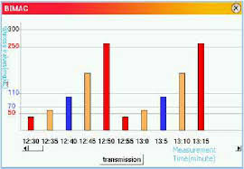

THE "WOW" IN OUR SOLUTION
3/21/2024 Annual Review
9

Slide 10
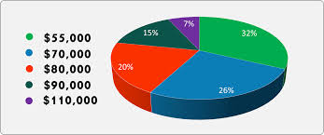
MODELLING
10

Slide 11
RESULTS
The term data analytics refers to the science of analyzing raw data to make conclusions about information. Many of the techniques and processes of data analytics have been automated into mechanical processes and algorithms that work over raw data for human consumption. Data analytics can be used by different entities, such as businesses, to optimize their performance and maximize their profits. This is done by using software and other tools to gather and analyze raw dat
11

Slide 12
conclusion
Data analytics is the process of analyzing raw data to draw conclusions and make informed decisions. Some conclusions that can be drawn from data analytics include:

